Slide 1

ONLINE FOOD DELIVERY SYSTEM
Under the guidance of
Pooja Mehta
Submitted By
Yamini Keerthi Vadlapatla
Maitrai Tumulury
ShivaKrishna Kalyadapu
Sachin Gupta
Bharath Marapaka

Slide 2
INTRODUCTION
Online food ordering is the process of ordering food, for delivery from a website or other application. The product can be either ready-to-eat food.
Despite the lack of personal interaction, the software provides online customers with the same features someone visiting the restaurant or ordering on the phone would have. This includes access to the entire menu with full customization.

Slide 3
PROJECT OBJECTIVE
To evaluate the way of interaction with customers.
To develop a restaurant ordering system with mobile application based on the client server application.
To determine the factors that influence customer when ordering food online.

Slide 4
TECHNOLOGIES USED
Spring Boot
Postman
MySQL
Maven

Slide 5
REQUIRED SPECIFICATIONS
Hardware Configuration | Software Configuration
Operating System : Windows 10 | Software IDE : Spring Boot
Hard Disk : 1 Tb | Language : Java
RAM : 8gb | Back End : MySQL Server , Postman

Slide 6
PROPOSED SYSTEM
This system is a bunch of benefits from various point of views. As this online application enables the end users to register to the system online, select the food items of their choice from the menu list, and order food online. And also user able to add, update and delete food items in cart.
System will store the information about new entry of food item, maintain quantity record, it will keep the record of the customer.

Slide 7
SPRING ANNOTATIONS
@Controller : The @Controller annotation indicates that a particular class serves the role of a controller. Spring Controller annotation is typically used in combination with annotated handler methods based on the @RequestMapping annotation.
@Autowired : The @Autowired annotation provides more fine-grained control over where and how autowiring should be accomplished.
@RequestMapping : @RequestMapping is one of the most common annotation used in Spring Web applications. This annotation maps HTTP requests to handler methods of MVC and REST controllers. In this post, you'll see how versatile the @RequestMapping annotation is when used to map Spring MVC controller methods

Slide 8
@PutMapping : Annotation for mapping HTTP PUT requests onto specific handler methods. Specifically, @PutMapping is a composed annotation that acts as a shortcut for @RequestMapping(method = RequestMethod. PUT) . consumes – Narrows the primary mapping by media types that can be consumed by the mapped handler.
@PostMapping : The @PostMapping is specialized version of @RequestMapping annotation that acts as a shortcut for @RequestMapping(method = RequestMethod. POST) . The @PostMapping annotated methods in the @Controller annotated classes handle the HTTP POST requests matched with given URI expression
@GetMapping : @GetMapping annotation maps HTTP GET requests onto specific handler methods. It is a composed annotation that acts as a shortcut for @RequestMapping(method = RequestMethod. GET)

Slide 9
@Entity : The @Entity annotation specifies that the class is an entity and is mapped to a database table.
@Table : The @Table annotation allows you to specify the details of the table that will be used to persist the entity in the database. The @Table annotation provides four attributes, allowing you to override the name of the table, its catalog, and its schema, and enforce unique constraints on columns in the table.
@JoinColumn : @JoinColumn is used to specify a column for joining an entity association or element collection. This annotation indicates that the enclosing entity is the owner of the relationship and the corresponding table has a foreign key column which references to the table of the non-owning side.

Slide 10
@Param : @param is a special format comment used by Javadoc to generate documentation. it is used to denote a description of the parameter (or parameters) a method can receive.
@PathVariable : The @PathVariable annotation is used to extract the value from the URL.
@RequestParam : @RequestParam annotation is used to read the form data and bind it automatically to the parameter present in the provided method
@RequestBody : The @RequestBody annotation allows us to retrieve the request's body. Spring has built-in mechanisms for deserializing JSON and XML objects into POJOs, which makes this task a lot easier as well.

Slide 11
@OneToOne Mapping : The @OneToOne JPA annotation is used to map the source entity with the target entity. Hibernate maps the tables in your database to the Entity classes in your application
@OneToMany Mapping : One-to-Many relationship between table A and table B indicates that one row in table A links to many rows in table B, but one row in table B links to only one row in table A.
@ManyToOne Mapping : Many-to-One mapping means that many instances of this entity are mapped to one instance of another entity.

Slide 12
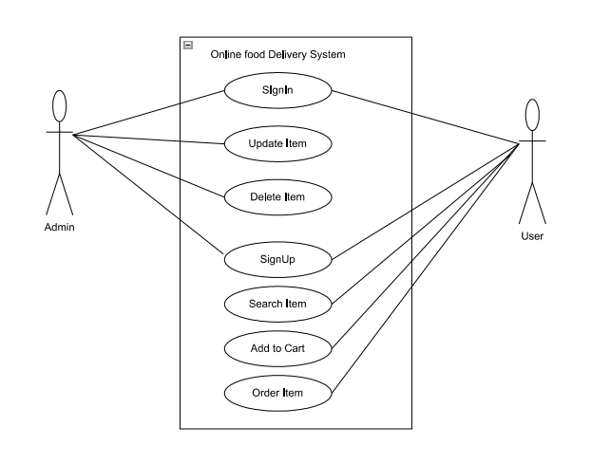
USECASE DIAGRAM

Slide 13
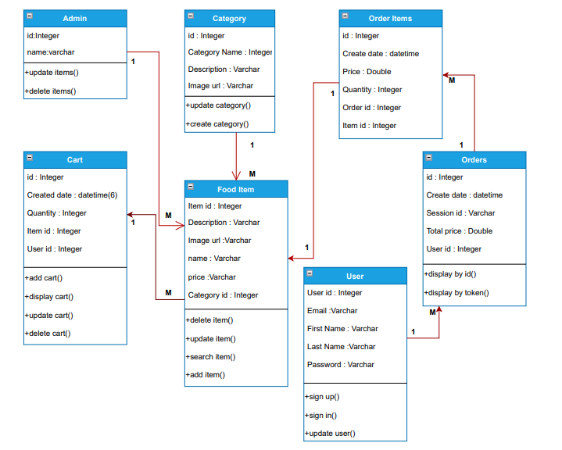
CLASS DIAGRAM

Slide 14
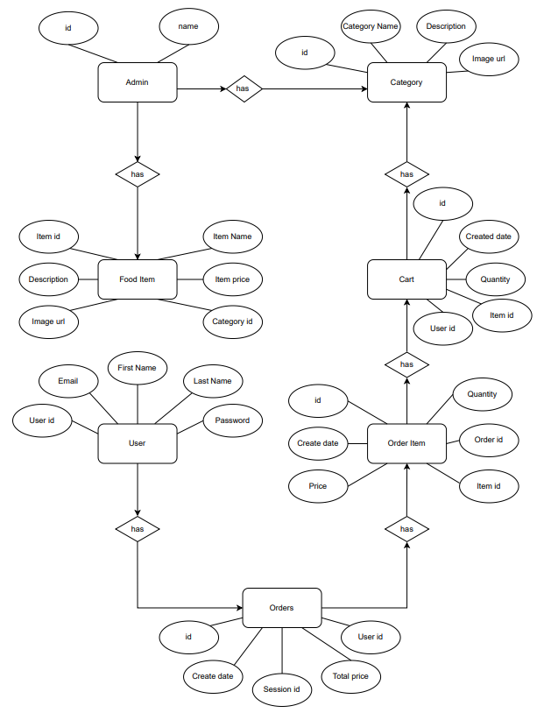
ER DIAGRAM

Slide 15
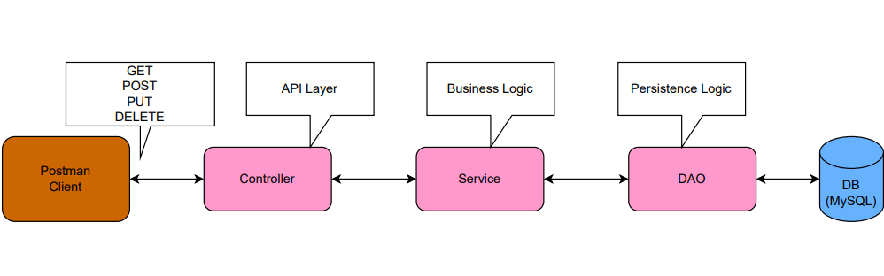
SYSTEM DIAGRAM

Slide 16
OUTPUT SCREENSHOTS

Slide 17
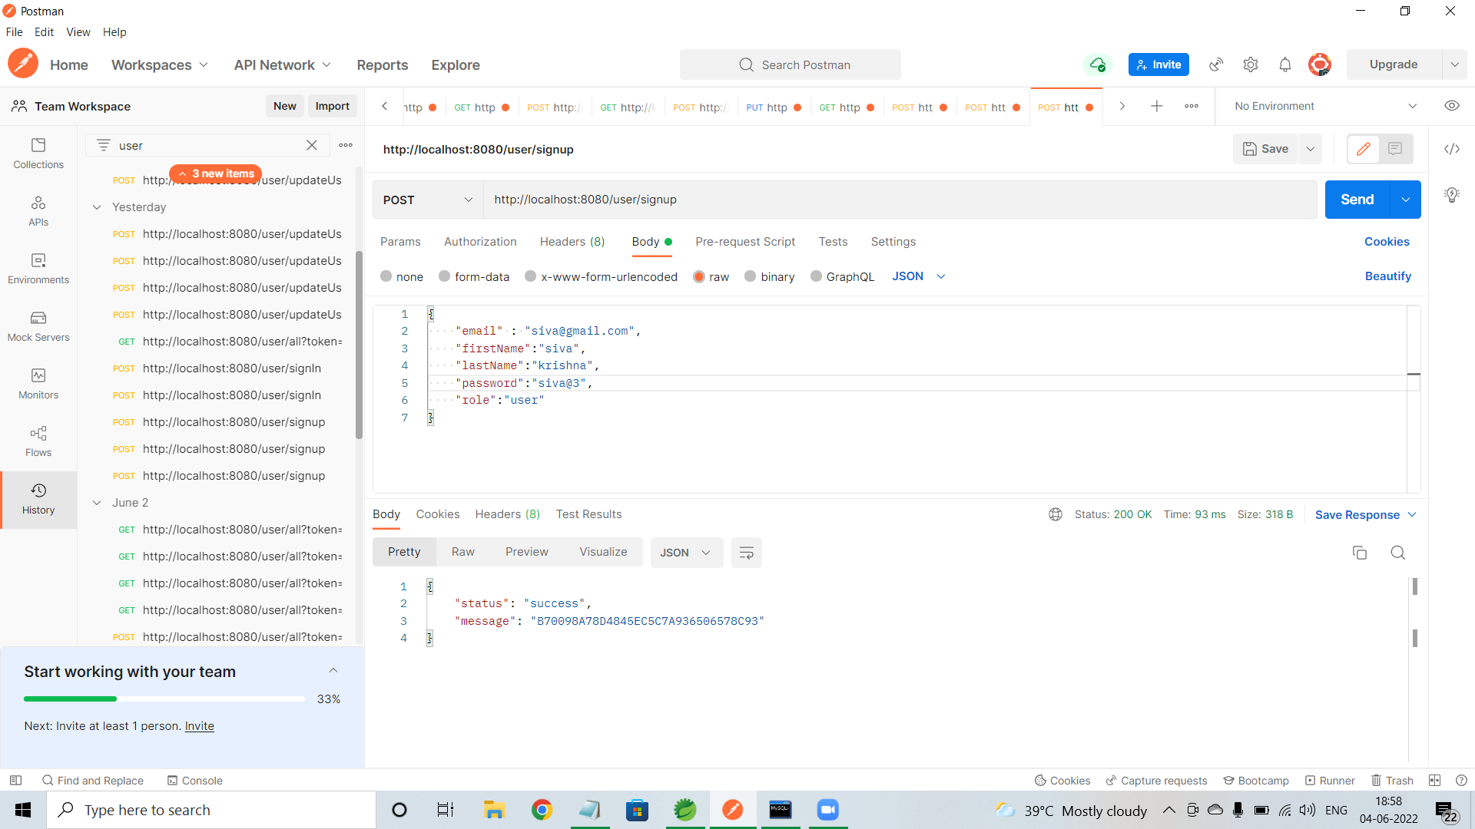
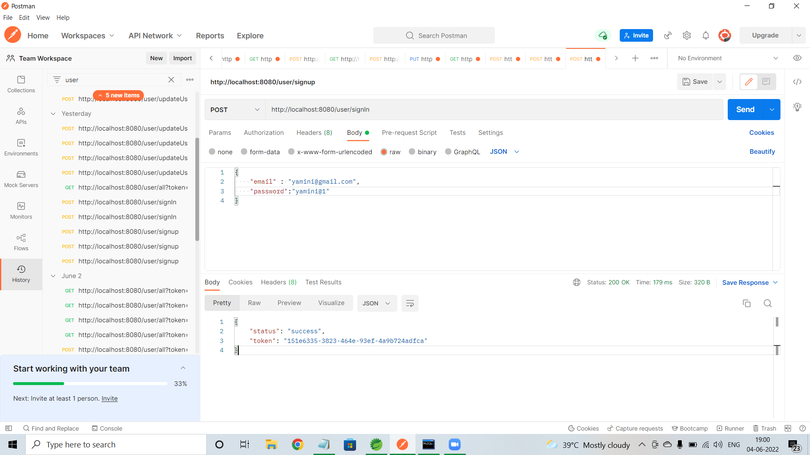
User/signup
User/signIn

Slide 18
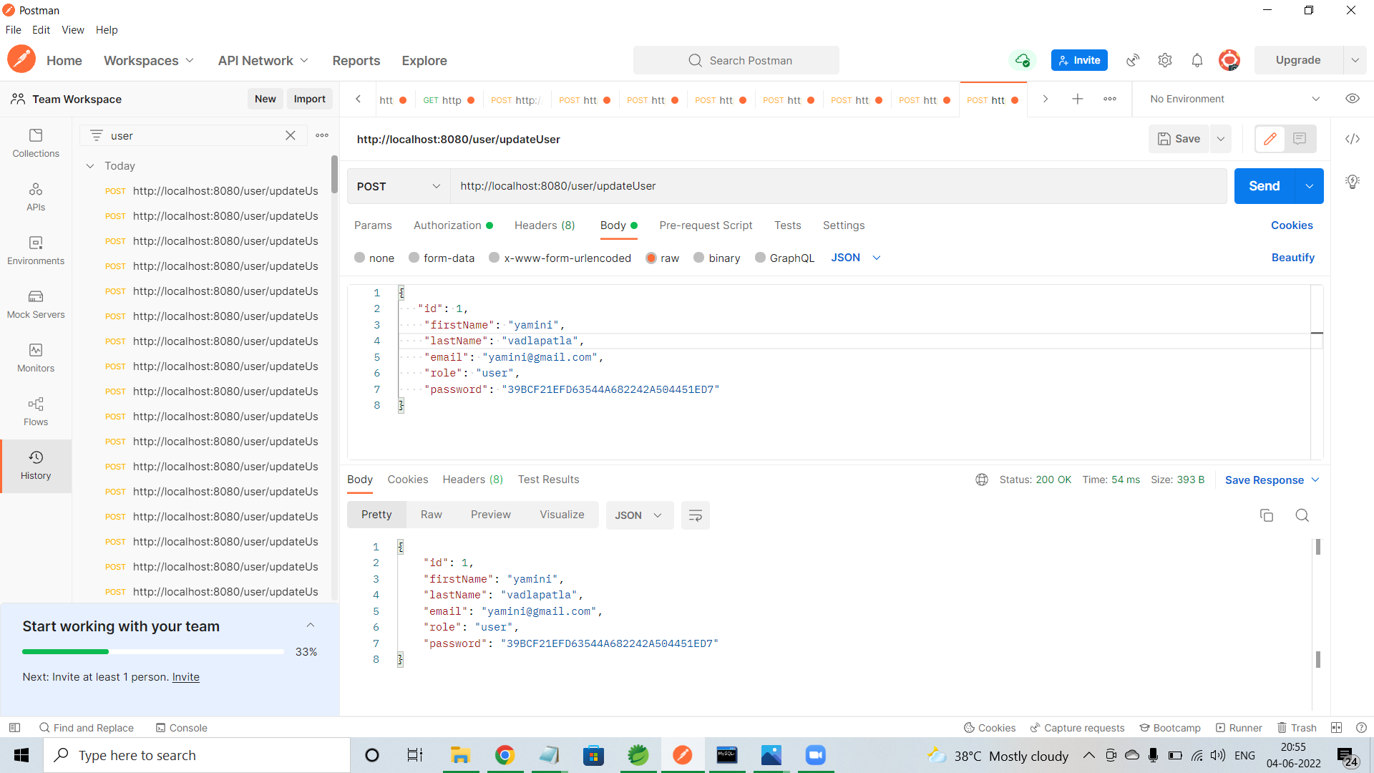
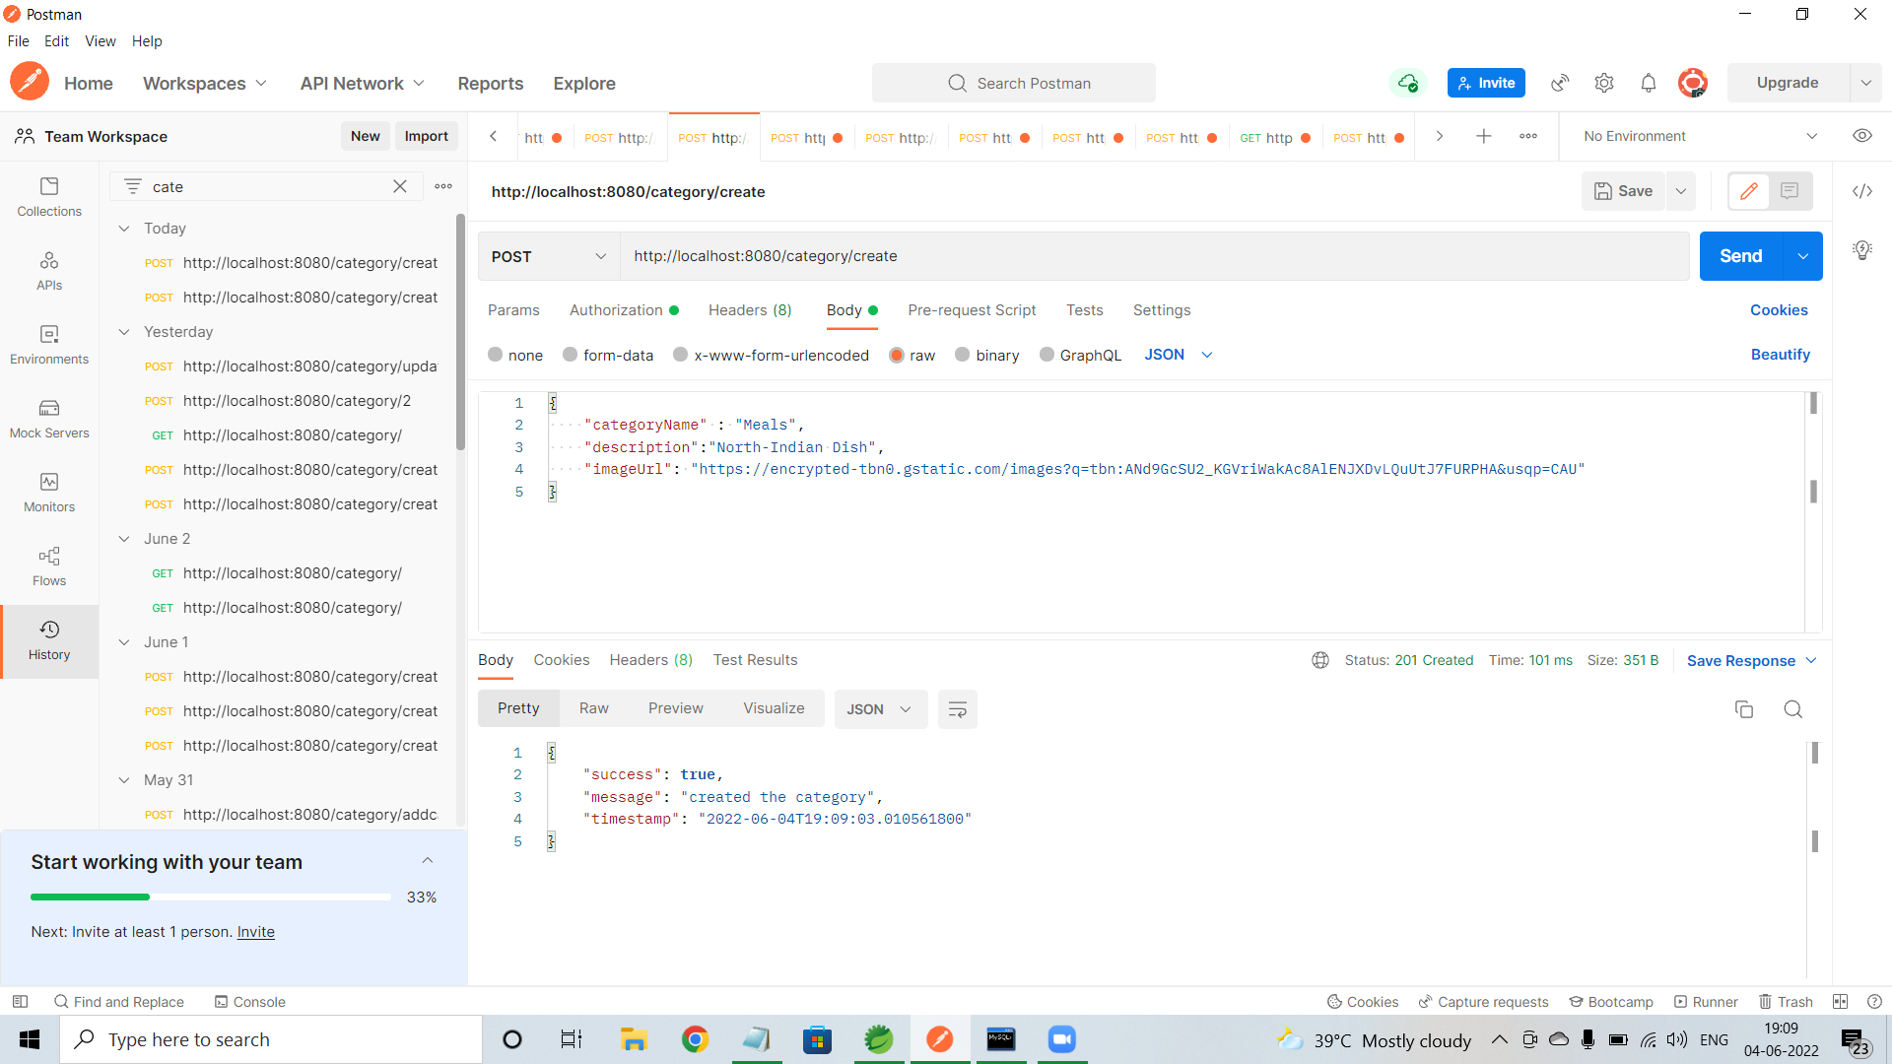
User/update
Category/create

Slide 19
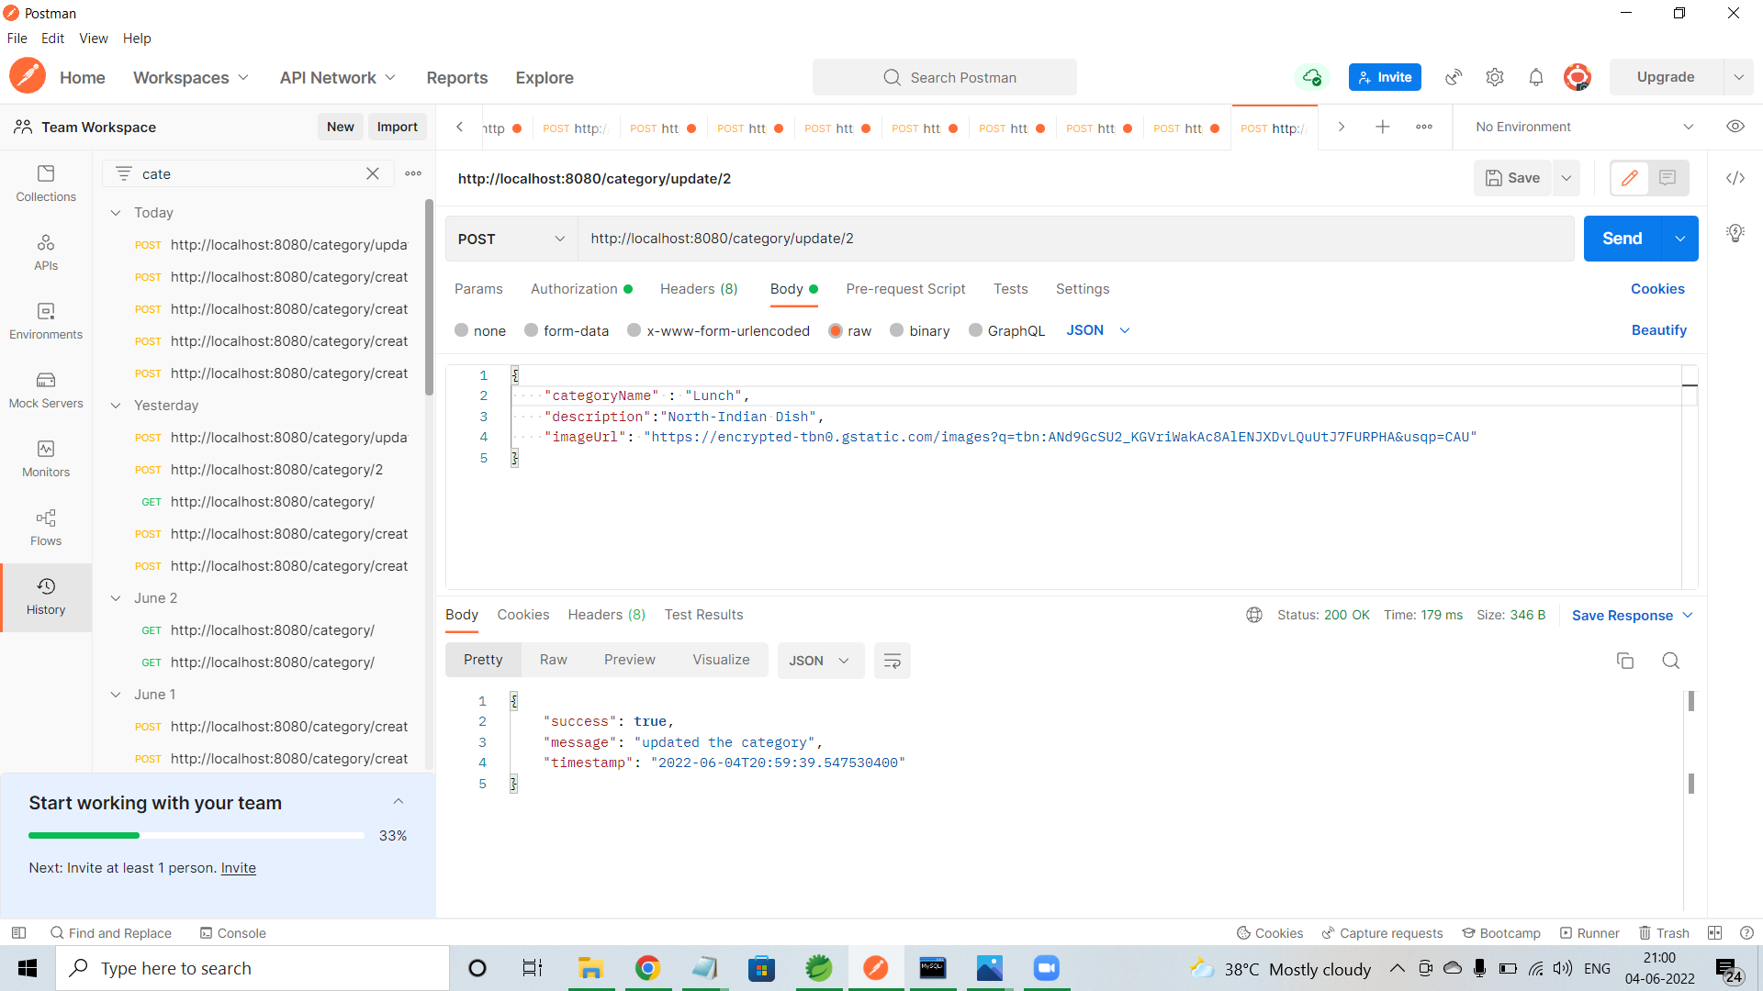
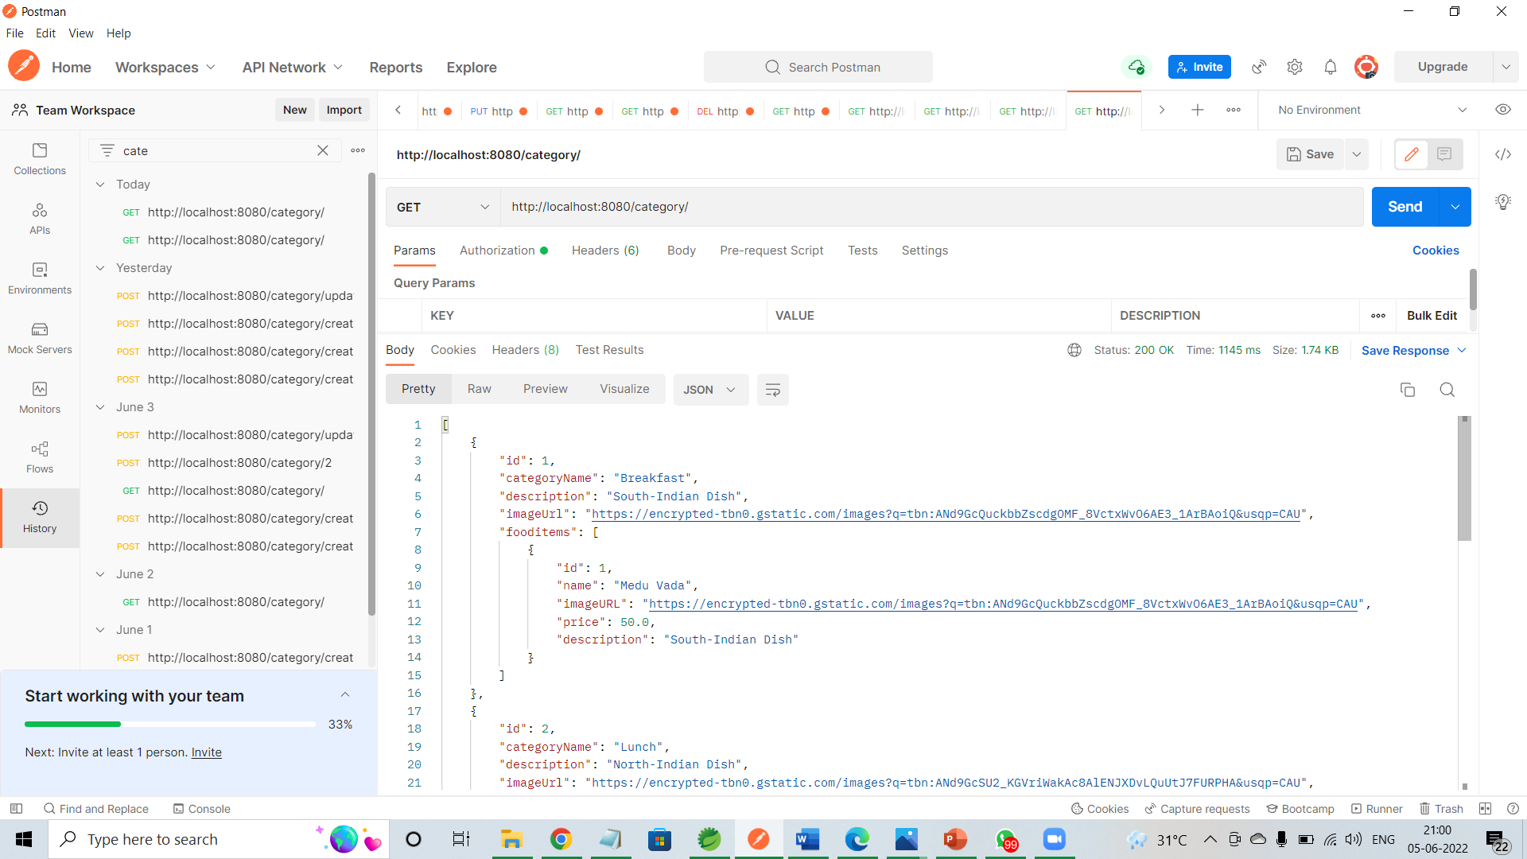
Category/update
Category/all

Slide 20
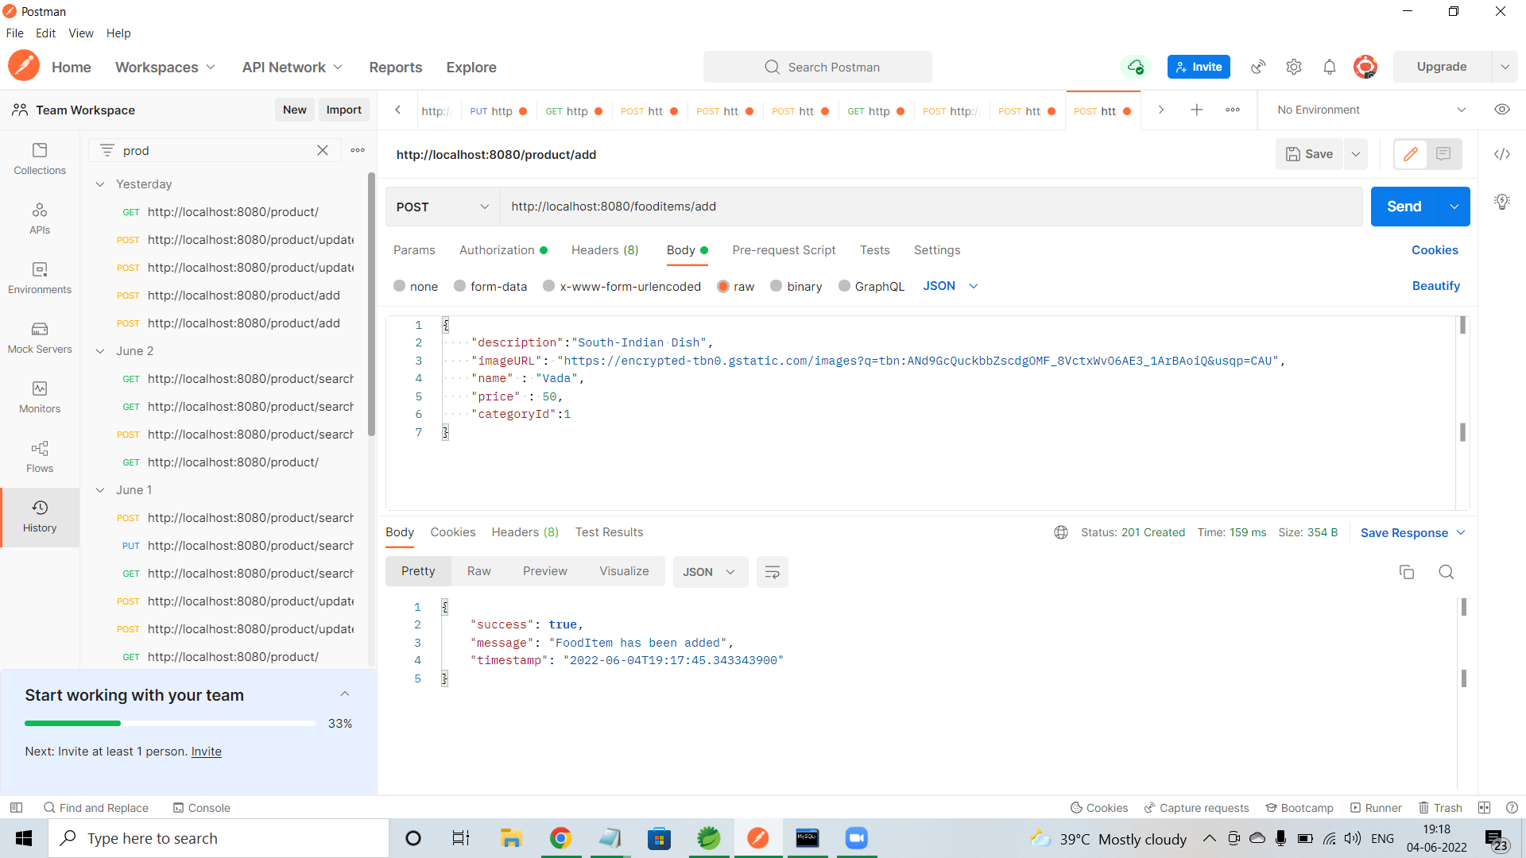
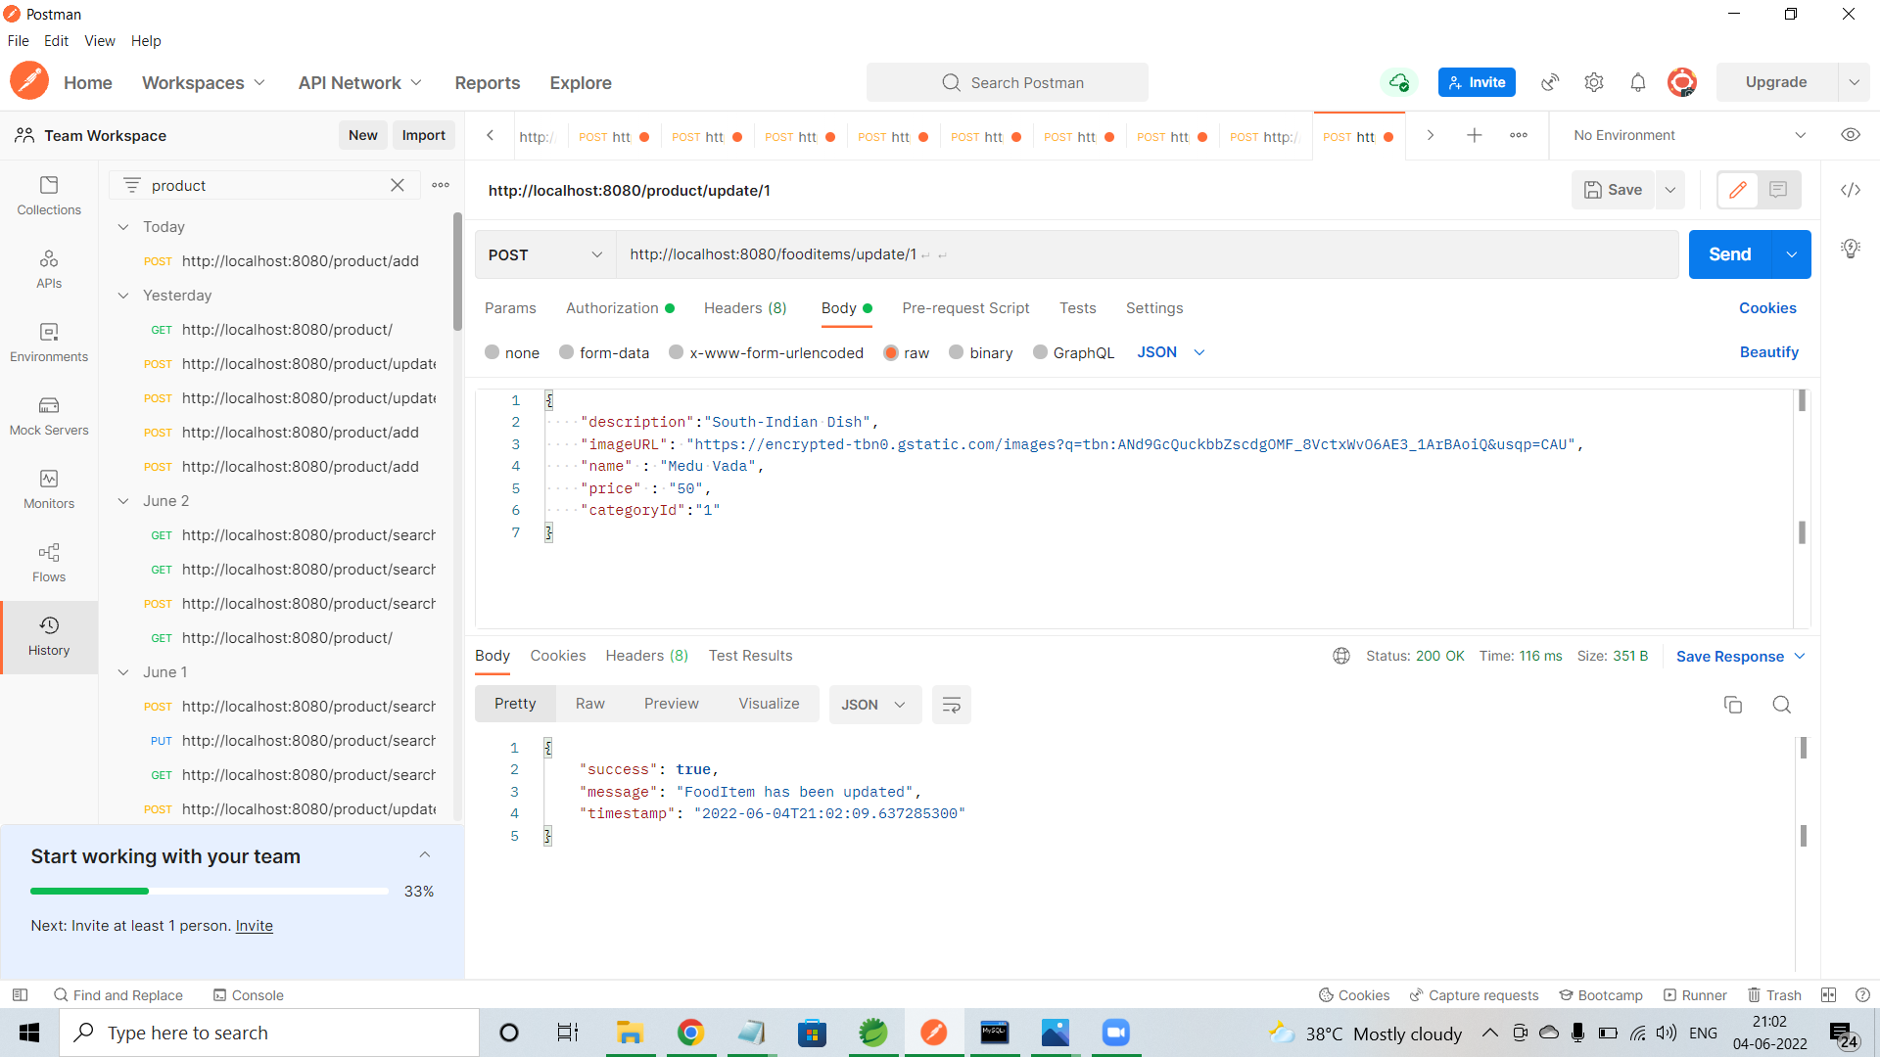
Fooditem/add
Food/update

Slide 21
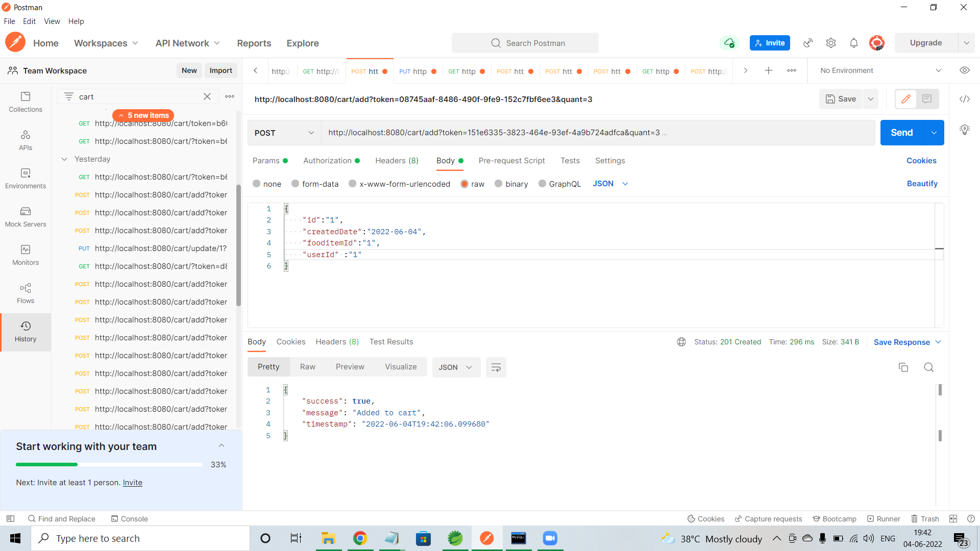
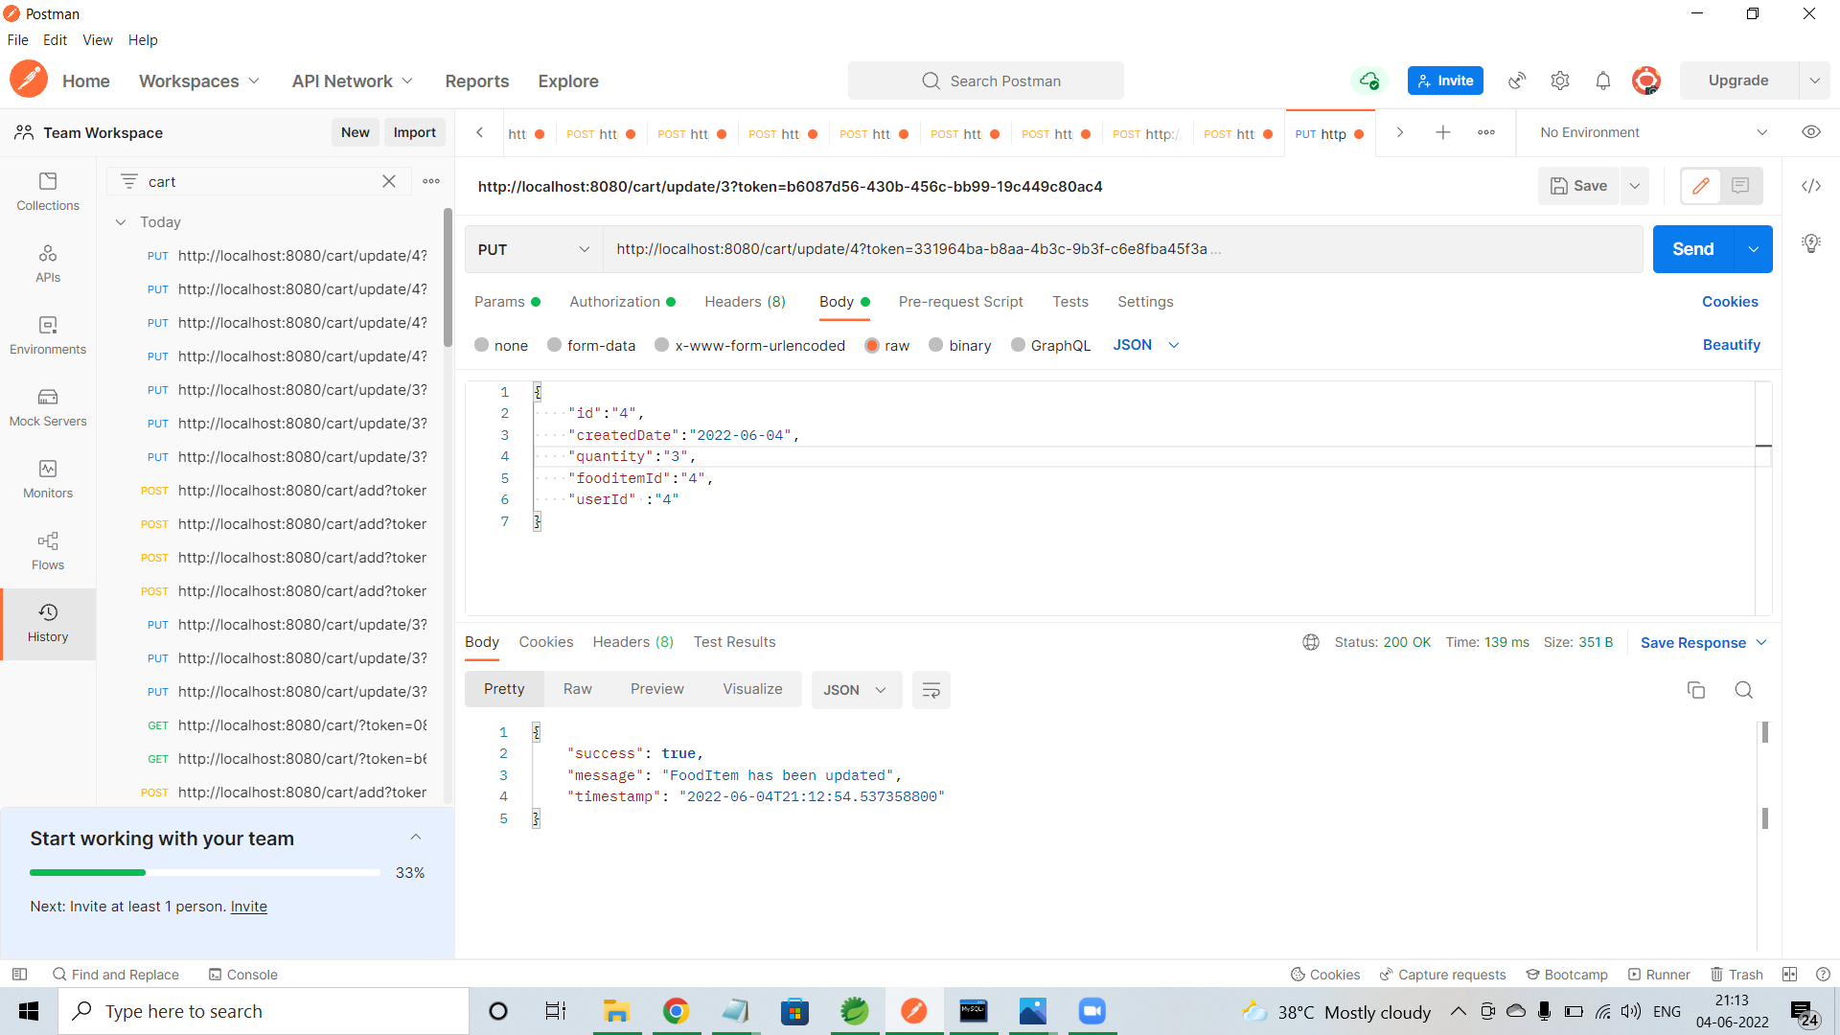
Cart/add
Cart/update

Slide 22
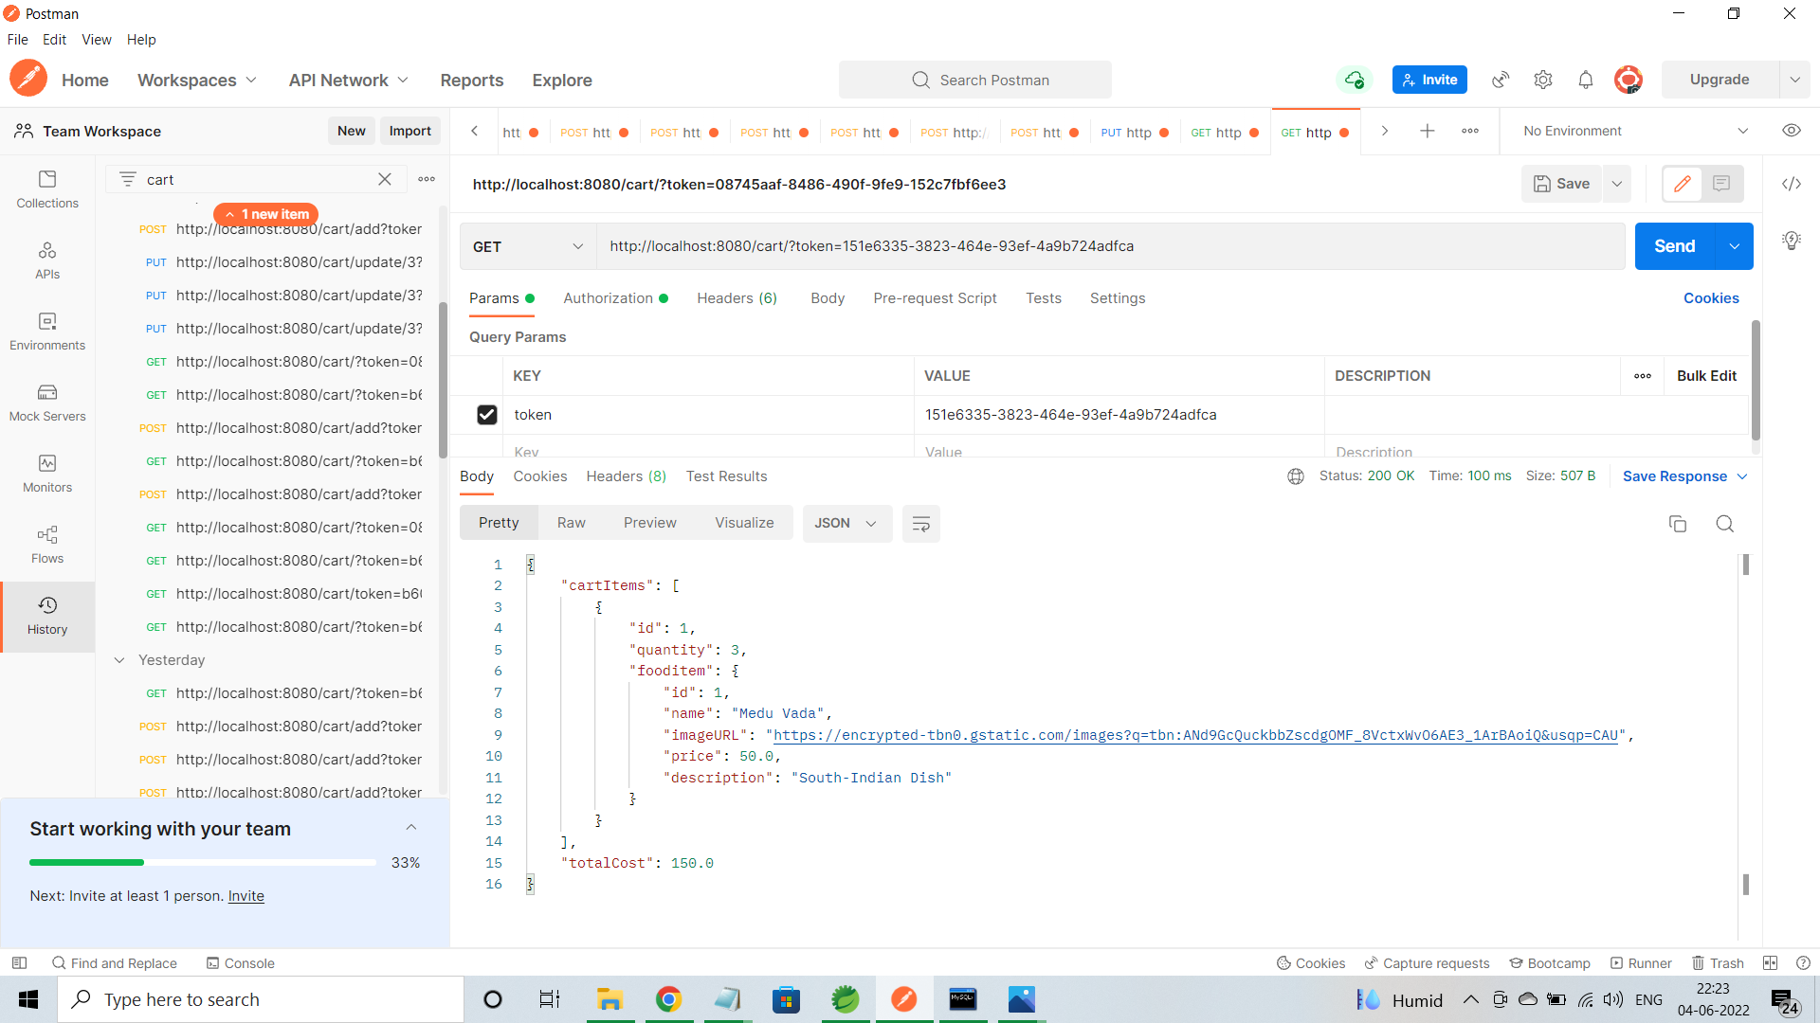
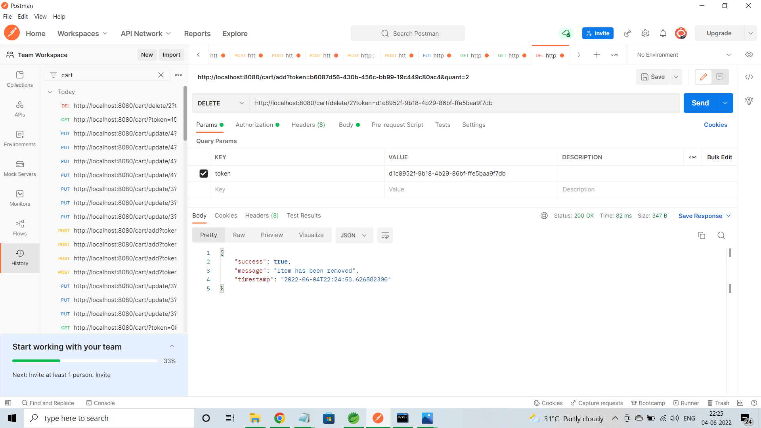
Cart/all
Cart/delete

Slide 23
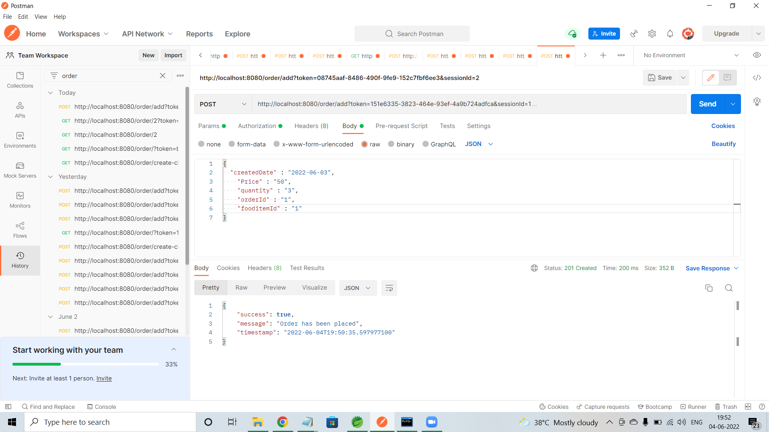
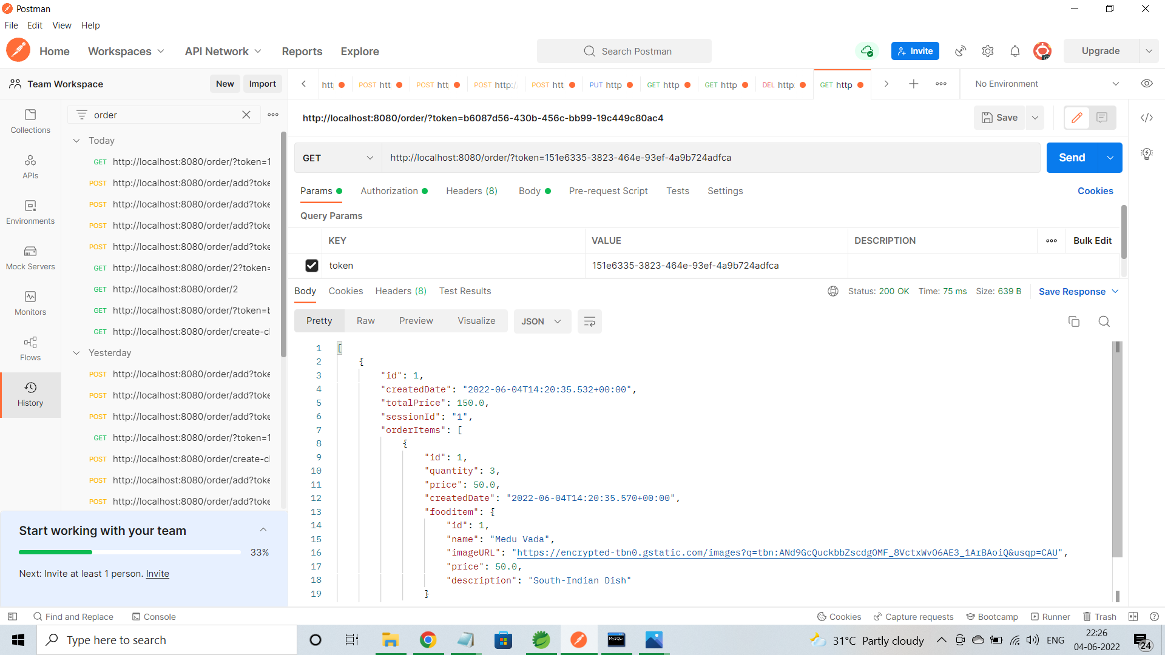
Order/add
Order/all

Slide 24
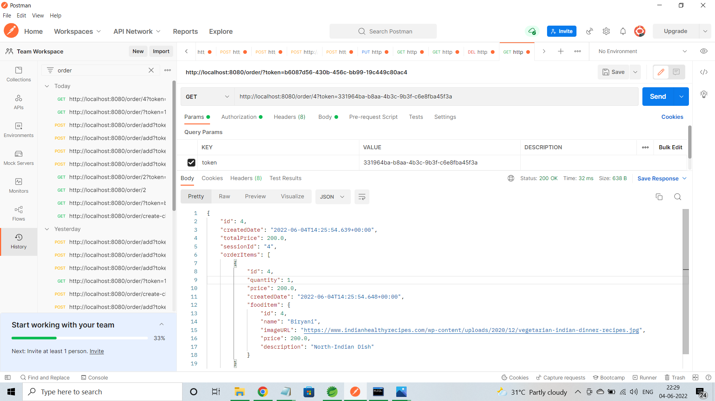
Order/all by id

Slide 25
ADVANTAGES
Clients can order whenever they want.
Makes the ordering process easier.
Customer’s satisfaction.
The convenience of mobile ordering.
No more waiting in long queues to place an order.
Discover New Items.

Slide 26
CONCLUSION
Online Food Ordering system is done to help and solve one of the important problems of customer. Because Large number of customer can use the internet and phone. Various issues related to Mess/Tiffin Service will be solved by these system. Thus, implementation of Online Food Ordering system is done to help and solve one of the important problems of customer. It helps customer in making order easily and gives information needed in making order to customer place.

Slide 27
THANK YOU

